Slide 1
The Core Conflict
Buy less to reduce liquidation risk
Limit the Range
Limit NPI risk
Protect Healthy Profitability (%)
Grow sales and Profitability faster
We are losing sales
Stock is growing
Buy more to protect availability
Present more Range
More NPI
Grow Sales
Notes:
Look at the current P&L, YTD we are growing 35% and we are not happy
1. The growth is not fast enough compare to the OE growth
2. Stock is high – and risk the throughput
The risk of every retailer is how much you really sell from what you buy
Our market is the most difficult one since gross margin is very low, we don’t have powerful tools to move the flow
(at fashion market, they can sell everything. They can have 40% discount and still make gross margin)
This is why we must be very sensitive to the buying – to the flow
Because we choose a side in the conflict – grow sales
But now the stock is a the problem, and we are moving to the other side
There is no escape from this conflict!!!
Other than to have the means to improve the flow and the effectiveness of the buying from good to excellent

Slide 2
The Solution- Full Eco System
Enable on-going synchronization between all the system needs

Slide 3
The Flow Challenge
Incoming SKU
Outgoing SKU
NPI
End of life
Not performing
Not available
Category / Price Band Range
Ranging
Replenishment

Slide 4
How to evaporate the conflict?
“Pull” rep and aggregation
Head strategy: protect availability
Effective NPI process
Range Alignment
Align to the market
protect the assortment
EOLM – liquidate on time
Protect Healthy Profitability
Grow sales and Profitability faster
Grow Sales

Slide 5
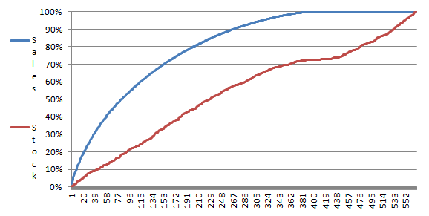
Different products behave differently
To increase Sales, Margins and Inventory turns each group of products must be rapidly identified and need to be addressed differently
Sales Driver
Variety Driver
Cost Driver
“Head”
“Belly”
“Tail”

Slide 6
“Pull” rep. and aggregation

Slide 7
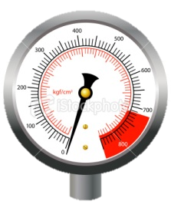
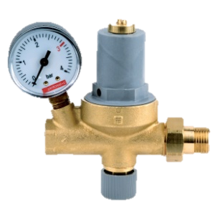
The Full Eco System – Store Level
Store / Display Group
Ranging
SKU4
NPI
SKU6
NPI Pilots Control
SKU3
SKU5
SKU2
Sales
SKU4
SKU1
SKU3
Replenishment
Liquidation
SKU2
SKU2
Depth Control
SKU1
SKU1
PB1
PB2
PB3

Slide 8
The Core Conflict
“Pull” rep and aggregation
Head strategy: protect availability
Effective NPI process
Range Alignment
Align to the market
protect the assortment: “Belly” Strategy
EOLM – liquidate on time
Protect Healthy Profitability (%)
Grow sales and Profitability faster
Grow Sales

Slide 9
Moving from “Push” to “Pull”
We can re-configure our supply chain from forecast driven to demand driven by adopting the three rules below:
Frequent Re-Supply to actual demand
Aggregarting Inventory up stream
(Demand Based) Dynamic buffers mangment
By holding most of our inventory in aggregation points rather than downstream we can significantly improve our response to the market demand
Re-aligning our inventory buffers frequently according to actual demand ensures that our inventory is in-line with demand

Slide 10
Frequent Replenishment
Frequent replenishment with
daily orders means:
quicker response to changes in demand,
avoiding shortages
lower average inventory, thus less exposure to
obsolescence (discounting and blocked sales)
Inventory
Time
time
Order
L.T.
Transport
L.T.

Slide 11





Pull Replenishment
Replenish to Real Consumption
RM
Suppliers
DC
Shops
RM
Suppliers
CDC
DC
DC
Shops
RM
Suppliers
Shops

Slide 12
Dynamic Buffer Management
Buffer = SKU level inventory target
Initial inventory target equals to the max consumption within a replenishment time
Inventory target is dynamic, re-aligned with actual demand
Replenishment is done to fill the buffer target
Target level
Excess
Low priority
WARNING!!
High Priority
Shortage
Very High Priority

Slide 13
Head Strategy
Focus to protect availability

Slide 14
The Core Conflict
“Pull” rep and aggregation
Head strategy: protect availability
Effective NPI process
Range Alignment
Align to the market
protect the assortment: “Belly” Strategy
EOLM – liquidate on time
Protect Healthy Profitability (%)
Grow sales and Profitability faster
Grow Sales

Slide 15
Identify Your Head
What is Head?
Various industries will use different rules of thumb to define Head
A generic rule that works:
SKUs contributing to 30% - 50% sales (usually – the top 10%-20% SKUs)
Definition on Category level
Why?
Short list enables focus
Why?
We secure sales across categories

Slide 16
Head Strategy
Management focus:
Best seller are defined twice a month, based on their actual performance
The short list enables focusing the discussion with the vendors on getting higher availability of the best sellers
We want to range best sellers to as many relevant stores as possible
We promote the available best sellers in our stores

Slide 17
NPI (New Product Introduction)
How to improve hit ratio and increase the effective range

Slide 18
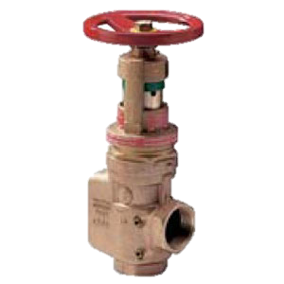
The Full Eco System
Store / Display Group
Ranging
SKU4
NPI
SKU6
NPI Pilots Control
SKU3
SKU5
SKU2
Sales
SKU4
SKU1
SKU3
Replenishment
Liquidation
SKU2
SKU2
Depth Control
SKU1
SKU1
PB1
PB2
PB3

Slide 19
Fast Market Feedback
The best data is real-time market data
Our size (About 1.4M footfall per month) and geographical spread enable us to get FAST real-time market feedback
The best preforming stores at the relevant Cat / PB (Assortment Group) will provide a good feedback in a short time.

Slide 20
NPI Processes
Create a representative pilot (duration of 5% - 15% of the products life span) that will deliver a reliable and fast feedback loop regarding the performance of the product
Use the pilot results in determining Go / No Go

Slide 21
NPI expected result
Expected Impact:
Higher effective range => Sales ↑
Less obsolescence => ROI↑
Introduction of more NP with the same cash investment:
Possibility for having more best sellers
Higher refreshment level and better competitive advantage

Slide 22
Range Alignment
Range Target Definition & Allocation Process

Slide 23
How much range to keep at the store?
On Saturation point, some of the potential good products can’t get the right attention
Sales
The right Assortment Target
Cost
Adding more assortment will not have any impact, might have negative impact – reduce brand image and costumers delay decision
Sales
2
Cost is expending:
More obsolesce
More logistic
More space
More people
Minimum Presentation point
1
Assortment
*We consider range everything that the customer can choose from
Notes:
This point is different pre store

Slide 24
The Full Eco System
Store / Display Group
Market Feedback
Ranging
Range Target
Variety Control
Gap
SKU4
NPI
Go /
No Go
SKU6
NPI Pilots Control
SKU3
SKU5
SKU2
Sales
SKU4
SKU1
SKU3
Rep.
Liquidation
SKU2
SKU2
Depth Control
SKU1
SKU1
PB1
PB2
PB3
Display Control

Slide 25
Range Alignment Steps
Setting a Range Target
Allocating to the Target

Slide 26
How to Set Range Target per Store / Assortment Group?
By having a systematic method that sets range targets based on store/assortment group performance.
New products
New products
More range has low chance to improve sales & turns
New products
More range has high chance to improve sales & turns
Decrease range target
Effective products
Effective products
Increase range target
Not Selling products
Non-Effective Products
Non-Effective Products
Store 1
Assortment Group X
Store 2
Assortment Group X

Slide 27
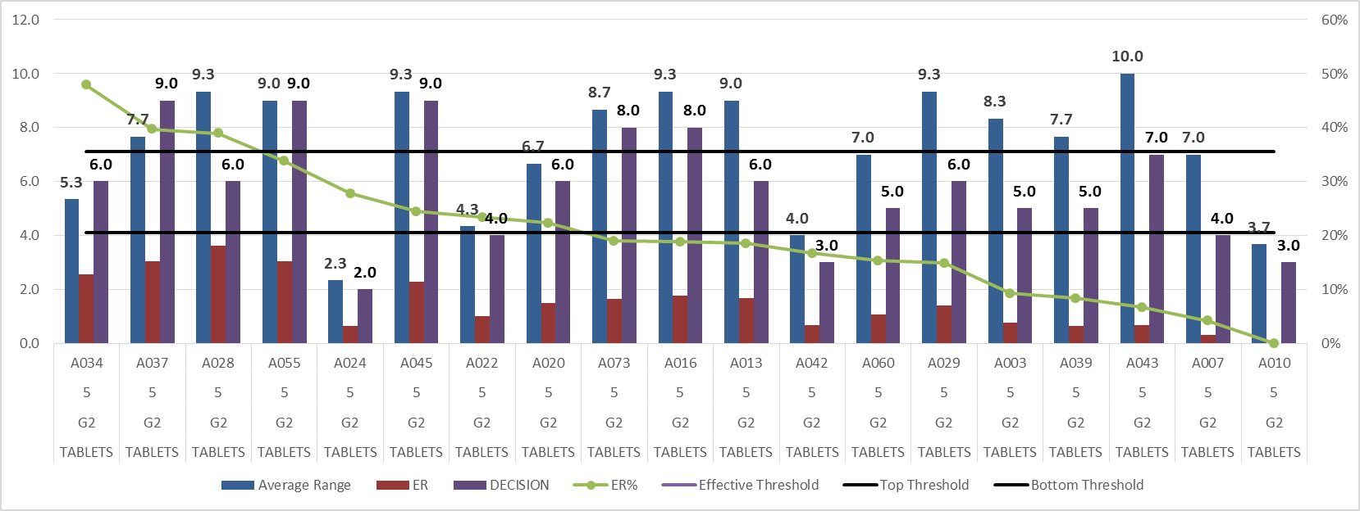
Display Group-Tablets
Step 1- AG5, Store Group G2:

Slide 28
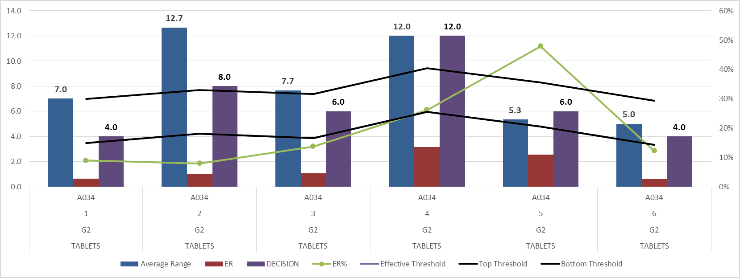
Display Group-Tablets
Step 2 (final decision) Store A034:

Slide 29
Range Alignment Steps
Setting a Range Target
Allocating to the Target
Protect the Range

Slide 30
Allocation process
Systematically allocate the available stock to the right stores considering:
Range the best available SKU at the DC to the most needed store
Keep range target and refreshment level
Manual decision will be done by the buyers in order to fine-tune the brands / spec mix
Manual decision will be done by the merchandiser in order to protect and improve slow stores

Slide 31
Control the range - Summary
Complying to the range target creates the right motivation: Flow, Flow, Flow
You must liquidate in order to refresh!
Process:
Define Store Range Target - Align the target to the store traffic
Comply to the range target – don’t allow to block the flow
Expected Impact:
Improve the relevance of the store assortment to the customer needs: sales ↑
Reduce the range where we don’t have the traffic – Turns↑
Ranging
Range Target
Variety Control
Gap
SKU4
SKU3
SKU2
SKU1
PB1

Slide 32
End of Life Management
Protecting the Flow

Slide 33
Full Automated Eco System

Slide 34
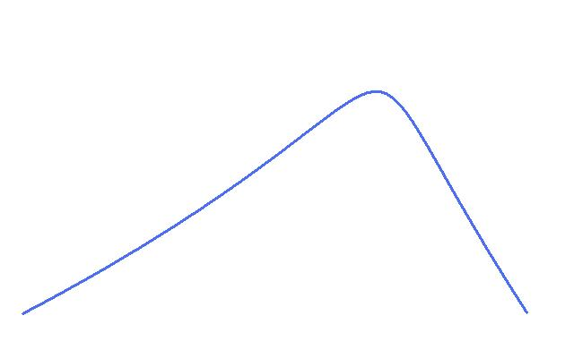
When to Liquidate?
Waiting will not give any advantage!
High chance to liquidate at discounted price
Sales
Need deep discount to liquidate
Low chance to liquidate
Time

Slide 35
EOLM Process
We systematically track and report each SKU/store performance/age
We are trying to improve slow moving SKUs:
Price correction
Stores knowledge / display
Rotation between stores
Where we can’t improve the SKU performance, we should act ASAP to liquidate

Slide 36
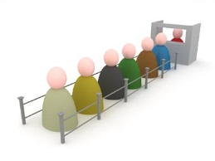
EOL Management Process
21 days
No Consumption for 21 days
of regular item (No SLM)
SLM1
Attempt to Save the item:
Price adjustment / Promotion
28 days
No
Are sales > 1 in the last 28 availability days since SLM1?
Yes
Remove “SLM1” from item
SLM2 Candidates
Queue:
Class min display for Rep items
Stop Replenishment
SLM2
Attempt to Save the margin:
Return to Vendor
IST to a store that recently sold this item
Return to DC
14 days
Small Discount
SLM3
21 days
Sharp Discount
SLM4
21 days
Remove from Store
SLM5

Slide 37
The Full Eco System
DC / Display Group
Store / Display Group
Market Feedback
Buying Priority
Ranging
Range Target
Variety Control
Gap
PB1
SKU4
PB2
PB3
NPI
Range Penetration
Go /
No Go
SKU6
NPI Pilots Control
SKU3
SKU5
SKU2
Sales
SKU4
SKU1
SKU3
Replenishment
Liquidation
SKU2
SKU2
Depth Control
SKU1
SKU1
Head SKUs:
Availability Focus
PB1
PB2
PB3
DC SLMs
Display Control

